Slide 1
An Ontology of Algorithms and Data Structures
Paul E. Black
National Institute of Standards and Technology
http://www.nist.gov/
paul.black@nist.gov

Slide 2
Dictionary of Algorithms and Data Structures (DADS)
http://www.nist.gov/dads/
Started 1998 for CRC’s Dictionary of Computer Science, Engineering, and Technology
More than 1,000 entries
Widely used resource for research community
  over 14,000 hits/day
Referenced as a resource in Science magazine
  vol 304, page 935, 14 May 2004, //www.sciencemag.org/cgi/reprint/304/5673/935d.pdf
In development as an O’Reilly book, e.g., Algorithms and Data Structures in a Nutshell
Notes:
The Dictionary has algorithms, data structures, definitions, and classic problems
It has entries in areas such as automata and state machines, graphs, trees, searching, sorting, complexity theory, combinatoric and numeric computation, and probabilistic algorithms.
Entries have an assortment of bibliographical references, links to web sites, links to implementations, and relationships between entries, like is-a, I’m-in, in-me, similar entries, etc.

Slide 3
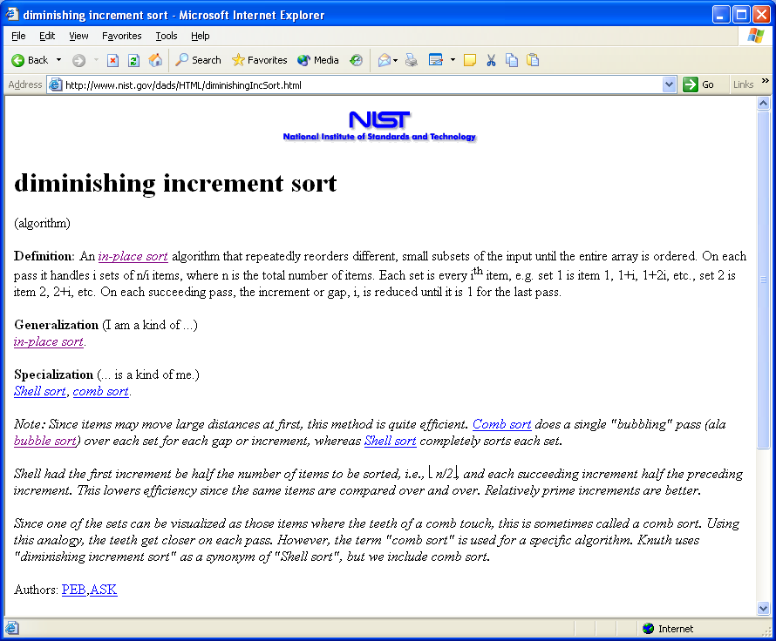
Typical DADS Entry

Slide 4


Why a DADS Ontology?
DADS is a very rich source with proven utility
“Practice” more precise queries, etc.
NIST and LM/ATL collaborating to develop an Ontology of Algorithms and Data Structures
  Based on an upper ontology ATL created
  NIST can host ontologies on the DADS site
Progress
  Second version of upper ontology created
  Third version of DADS ontology generated from Dictionary
Ontology has been checked with protégé

Slide 5
Algorithm Upper Ontology
:Algorithm a owl:Class;
rdfs:comment "An instance of this class is computable set of steps to achieve a desired result.";
rdfs:subClassOf :MathematicalThing;
rdfs:label "Algorithm".
:AlgorithmicTechnique a owl:Class;
rdfs:comment "An instance of this class is a general computational technique. An Algorithmic Technique is NOT an Algorithm; rather, Algorithms use Algorithmic Techniques.";
rdfs:label "Algorithmic Technique".
:DataStructure a owl:Class;
rdfs:comment "An instance of this class is an organization of information, usually in memory, for better algorithm efficiency, such as queue, stack, linked list, heap, dictionary, and tree, or conceptual unity, such as the name and address of a person. It may include redundant information, such as length of the list or number of nodes in a subtree.";
rdfs:subClassOf :MathematicalThing;
rdfs:label "Data Structure".
:AbstractDataType a owl:Class;
rdfs:comment "An instance of this class is a set of data values and associated Algorithmic Techniques that are precisely specified independent of any particular implementation. Abstract Data Types can be components of either Algorithms or Data Structures.";
rdfs:subClassOf :MathematicalThing;
rdfs:label "Abstract Data Type".
:complexity_Worst a owl:DatatypeProperty;
rdfs:comment "This property relates an algorithm with a string conveying its worst case complexity, e.g., O(n^2).";
rdfs:label "Worst Case Complexity";
rdfs:domain :Algorithm;
rdfs:range <http://www.w3.org/2001/XMLSchema#string>.
Defines fundamental concepts for algorithms and data structures
Defines salient semantic relations
Defines language for referring to implementations of specific algorithms
Coded in Notation 3 (N3) format for human & computer readability

Slide 6
Algorithm Ontology
:KWayMergeSort a dads:Algorithm;
rdfs:comment "A merge sort that sorts a data stream using repeated merges. It distributes the input into $k$ streams by repeatedly reading a block of input that fits in memory, called a <em>run</em>, sorting it, then writing it to the next stream. It merges runs from the k streams into an output stream, then repeatedly distributes and merges the runs until there is a single sorted output.";
rdfs:label "k-way merge sort".
:LasVegasAlgorithm a dads:AlgorithmicTechnique;
rdfs:comment "A randomized algorithm that always produces correct results, with the only variation from one run to another being its running time.";
rdfs:label "Las Vegas algorithm".
:LeftistTree a dads:DataStructure;
rdfs:comment "A priority queue implemented with a variant of a binary tree. Every node has the distance to the nearest leaf. In addition to the heap property, the right descendant of each node is closer to a leaf.";
rdfs:subClassOf :PriorityQueue;
dads:aggregateChild :BinaryTree;
dads:aggregateChild :HeapProperty;
rdfs:label "leftist tree".
:LeftistTreeImplementation1 a dads:Program;
dads:implements :LeftistTree;
dads:implementationLanguage "C";
dads:implementationURL <http://www.dcc.uchile.cl/~rbaeza/handbook/algs/5/516.del.c>
We used the existing dictionary to create the ontology
Contains over 2400 terms
  Algorithms
  Data Structures
  Definitions
  Abstract Data Types
  Implementations

Slide 7
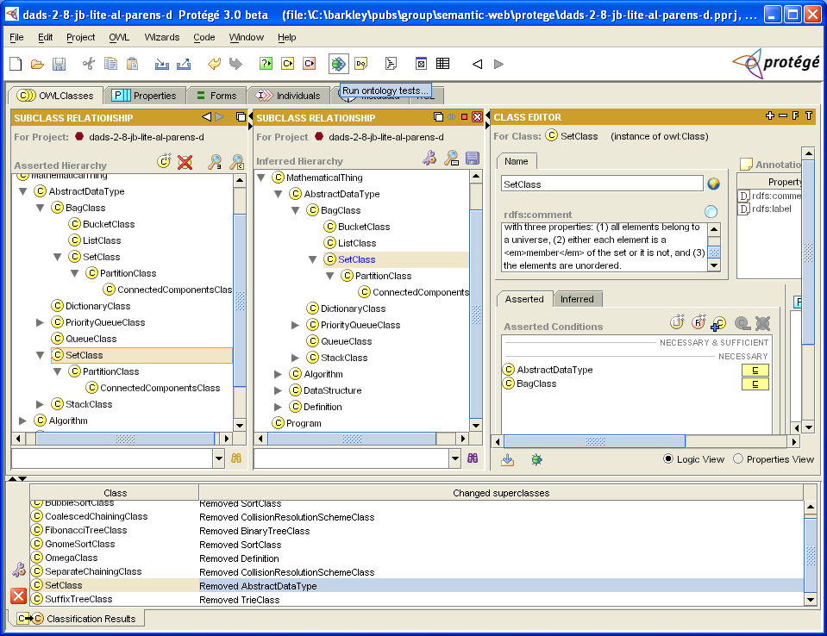
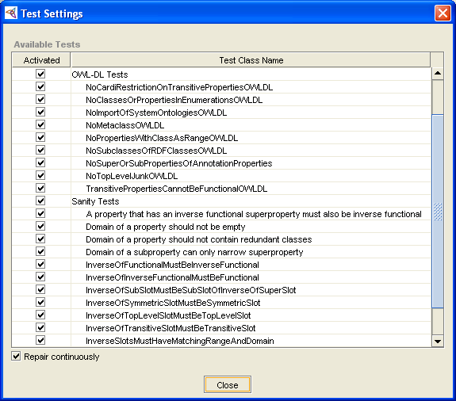
DADS Semantic Validation
Protégé tests ontology for:
  ambiguity
  consistency
  omission
  logic complexity to ensure that queries are decidable
  “good practices”

Slide 8
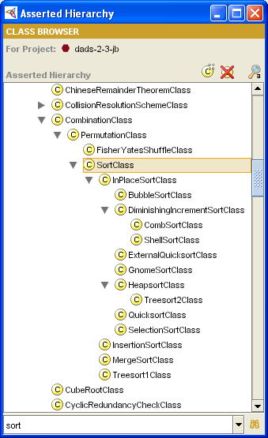
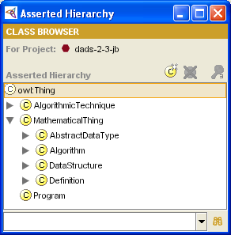
Browse by Class
Top level

Slide 9
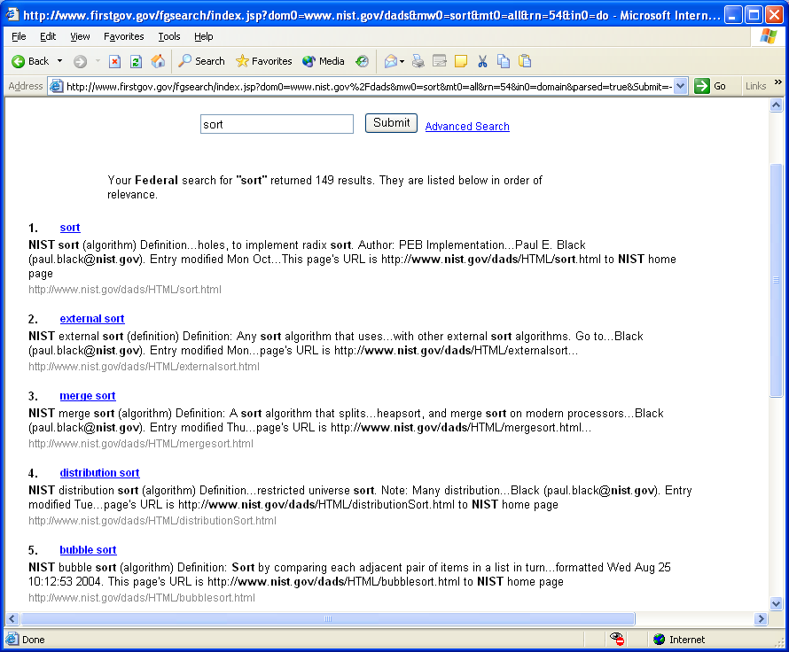
Problem: Full Text Query “sort”
149 items found
Relevance must be determined manually

Slide 10
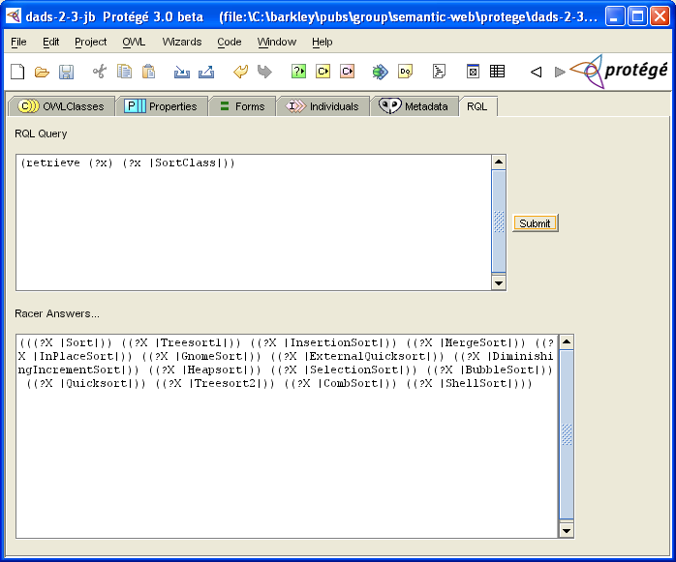
Semantic Query “SortClass”
Protégé returns exactly the 15 sort algorithms

Slide 11
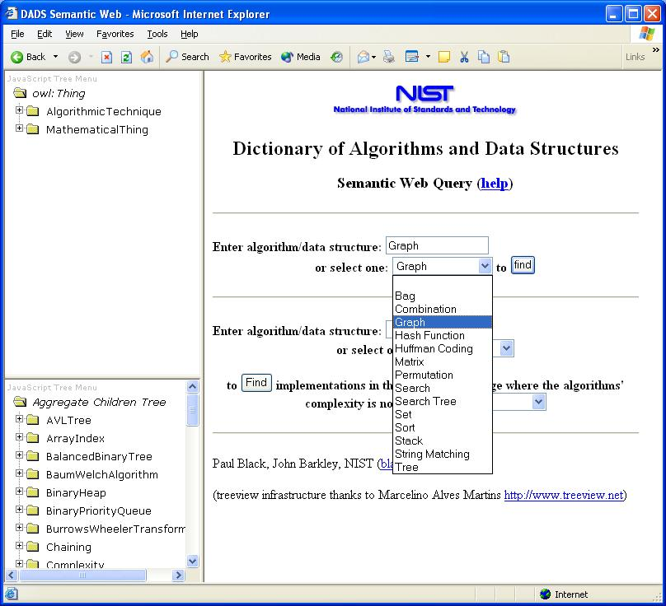
Semantic Web Query
http://xlinux.sdct.nist.gov/jb/dads-sem-web/dads-semantic-web.html
Search by name
Search by name, implementation language, and complexity
Browse in ontology
View aggregate children

Slide 12
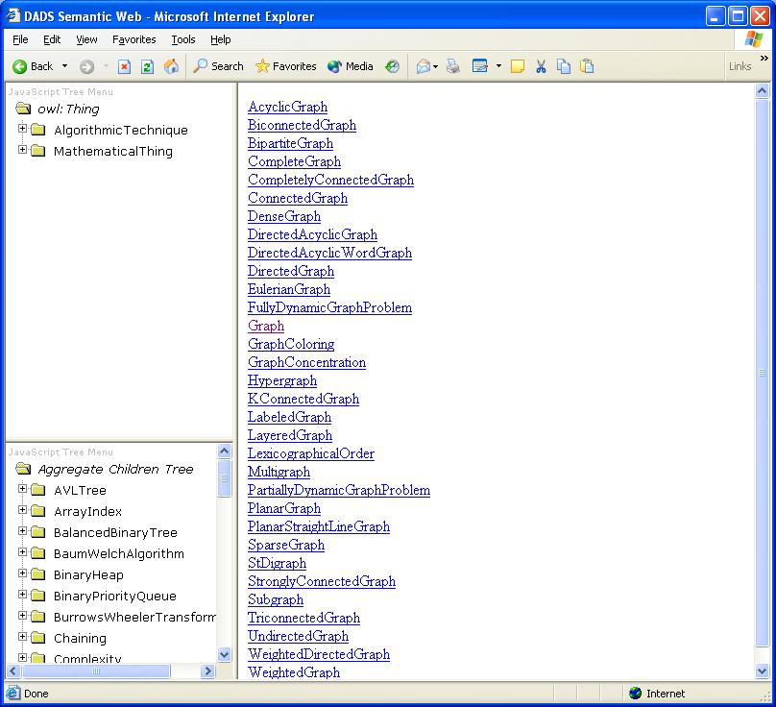
Query Entity Names for “graph”
Search by name
Search by name, implementation language, and complexity
Browse in ontology
View aggregate children

Slide 13
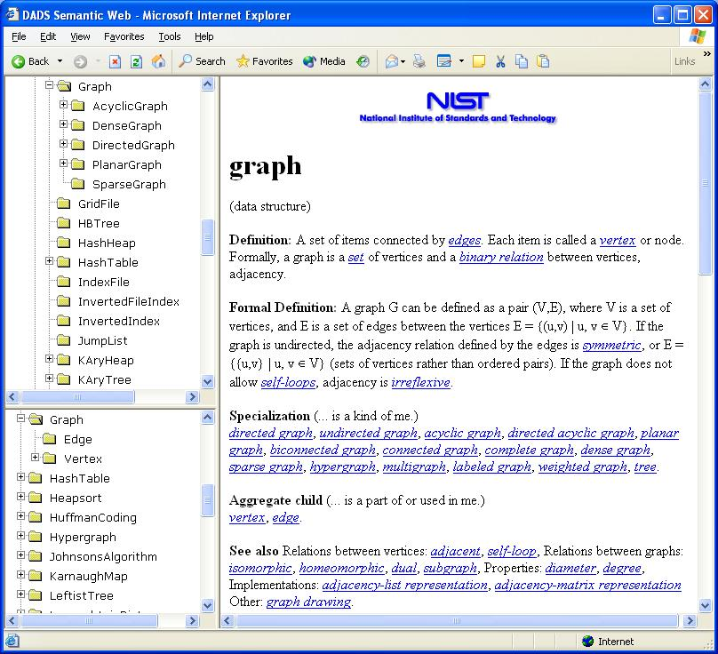
Click Graph to see:
Relation in ontology
Aggregate children
DADS entry

